Slide 2
Long Acting Injectable Agents for PrEP
Myron S. Cohen
The University of North Carolina at Chapel Hill

Slide 3
Dr. Cohen is disclosing the following potential conflicts as recommended by the Conference:
HIV Prevention Trials Network Co-PI
Consulting: Merck, Gilead
Stockholder and equity: None to report.
Patents and intellectual property: None to report.
Board of Directors Qura

Slide 4
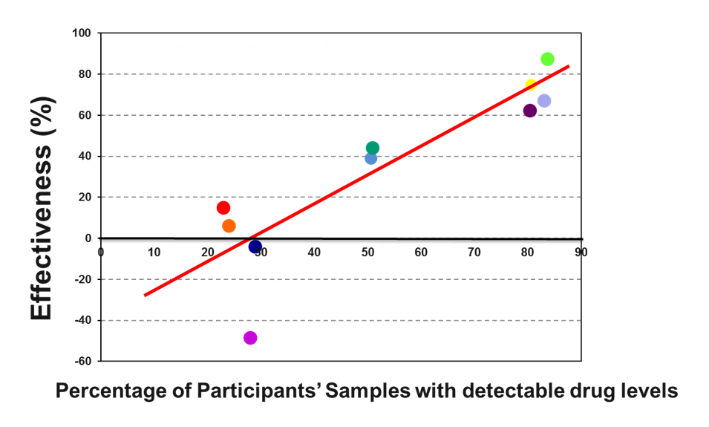
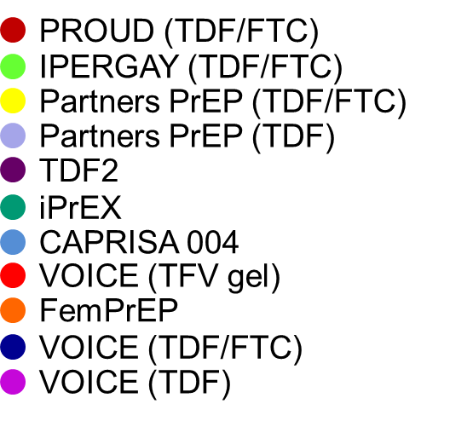
Effectiveness of Daily TDF/FTC in Clinical Trials
SS Abdool Karim, personal communication

Slide 5
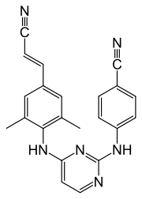
Long-Acting Injectables: Rilpivirine
Rilpivirine LA is a long-acting nanosuspension for delivery via IM injection (regulatory approvals for HIV treatment in combination with other ART agents – in development with CAB LA)
Agent class: Non-nucleoside reverse transcriptase inhibitor
Half-life:
    Oral: 45 hours
    Injectable: 90 days
RILPIVIRINE

Slide 6
HPTN 076: RPV LA in low-risk HIV-uninfected women
Objective: To evaluate the safety and acceptability of rilpivirine LA in healthy, HIV-uninfected females.
WEEKS 4 52 76
ARM 1 N = 91 | Daily oral RPV | Six injections of RPV LA 1200 mg every 8 weeks | Follow-up phase (tail phase)
ARM 2 N = 45 | Daily oral placebo | Six injections of placebo every 8 weeks

Slide 7
HPTN 076: Phase 2 Safety Results
  Two 2mL IM injections every 8 weeks were safe, well-tolerated, and acceptable to women
  Lower quartile RPV concentrations were consistently above the PA-IC₉₀ 8 weeks post injection at all time points
  Cold chain required
Bekker LG, CROI 2017. Abstract 421 LB.

Slide 8
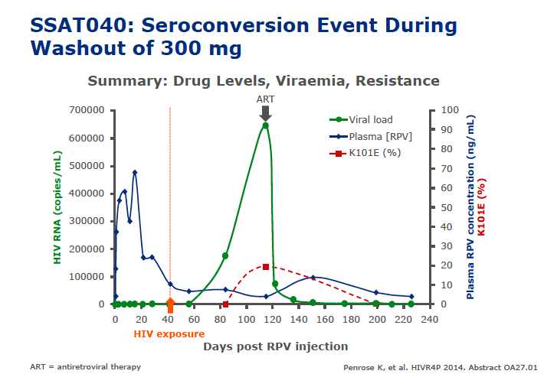
Seroconversion during pharmacokinetic tail after 300 mg IM dose

Slide 9
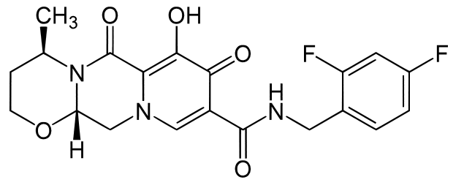
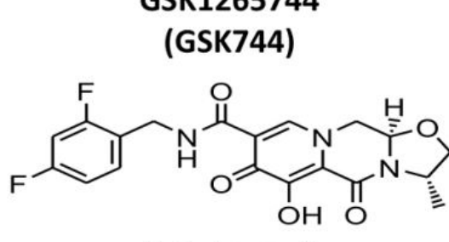
Long-acting Injectables: Cabotegravir
Cabotegravir LA is a long-acting suspension for delivery via IM injection (Currently in advanced development for Maintenance of virologic suppression [with RPV LA] and PrEP-monotherapy)
Agent class:
    Strand-transfer integrase inhibitor
Half-life:
    Oral: 40 hours
    Injectable: 40-65 days
DOLUTEGRAVIR
CABOTEGRAVIR

Slide 10

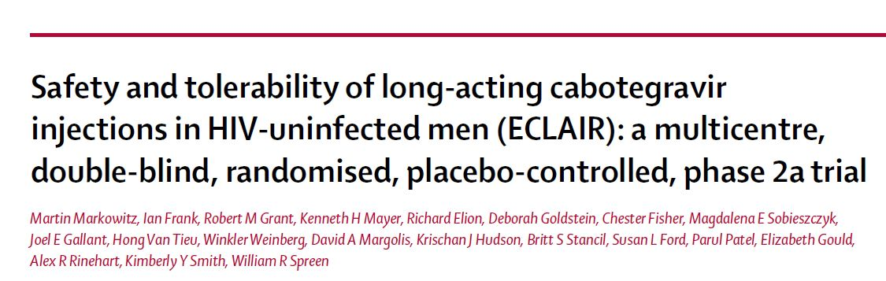
Lancet HIV. 2017 Aug;4(8):e331-e340

Slide 11
  Satisfaction and acceptability of cabotegravir long-acting injectable suspension for prevention of HIV: Patient perspectives from the ECLAIR trial
  Miranda I. Murray, Martin Markowitz, Ian Frank, Robert M. Grant, Kenneth H. Mayer, Krischan J. Hudson, Britt S. Stancil, Susan L. Ford, Parul Patel, Alex R. Rinehart, William R. Spreen & David A. Margolis
HIV Clin Trials. 2018 Aug;19(4):129-138

Slide 12

Expanding the Menu of HIV Prevention Options: A Qualitative Study of Experiences with Long-Acting Injectable Cabotegravir as PrEP in the Context of a Phase II Trial in the United States
Kerrigan D, Mantsios A, Grant R, Markowitz M, Defechereux P, La Mar M, Beckham SW, Hammond P, Margolis D, Murray M
AIDS Behav. 2018 Nov;22(11):3540-3549

Slide 13



11
NOVEMBER 2018
15
Safety, tolerability, and pharmacokinetics of long-acting injectable cabotegravir in low-risk HIV-uninfected individuals: HPTN 077, a phase 2a randomized controlled trial
Landovitz RJ, Li S, Grinsztejn B, Dawood H, Liu AY, Magnus M, Hosseinipour MC, Panchia R, Cottle L, Chau G, Richardson P, Marzinke MA, Hendrix CW, Eshleman SH, Zhang Y, Tolley E, Sugarman J, Kofron R, Adeyeye A, Burns D, Rinehart AR, Margolis D, Spreen WR, Cohen MS, McCauley M, Eron JJ
Advancing the beneficial use of machine learning in health care and medicine: Toward a community understanding
PLoS Med. 2018 Nov 8;15(11):e1002690

Slide 14
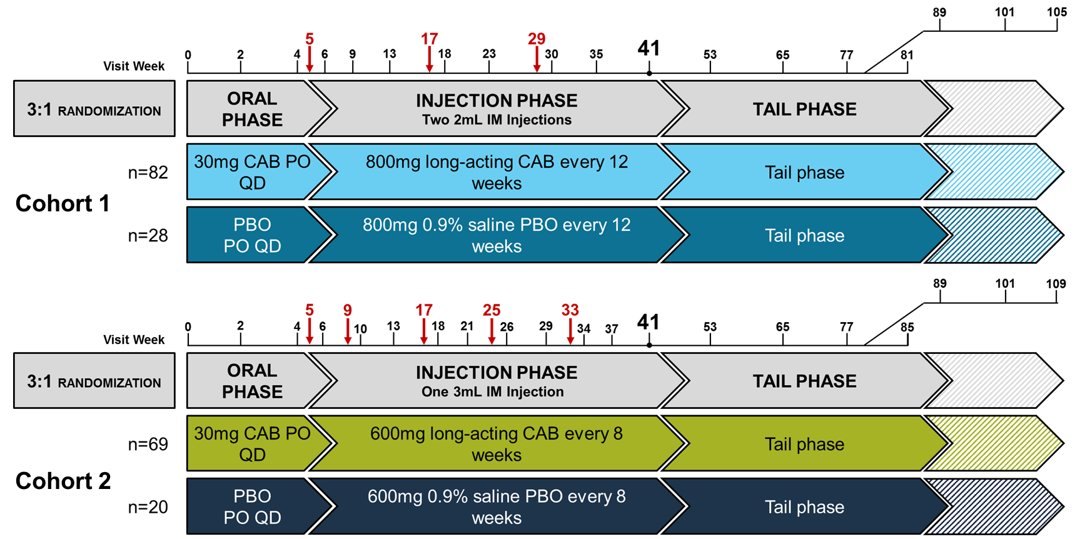
CAB LA in Development: HPTN 077
Objective: To evaluate the safety, tolerability, and pharmacokinetics of CAB LA in healthy, HIV-uninfected males and females.
Landovitz, R et al. HIV R4P, Madrid, 2018. Abstract #OA15.06LB.

Slide 15
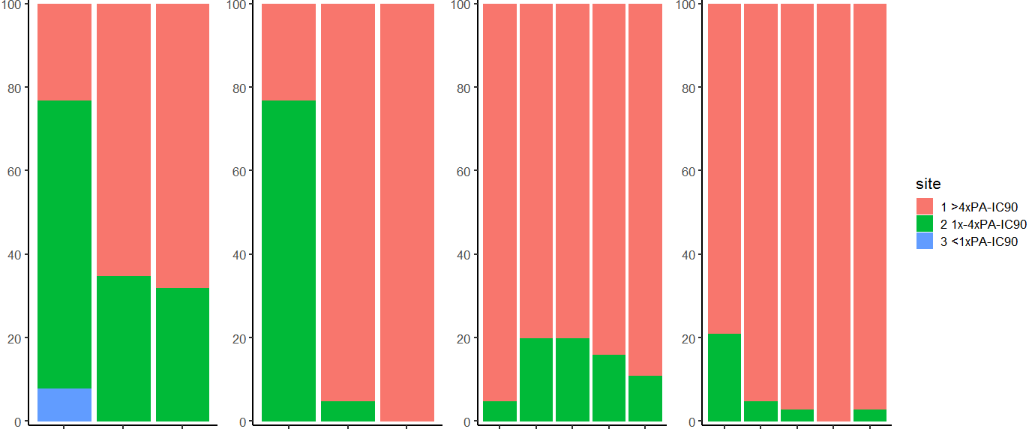
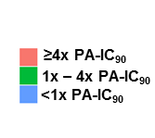
HPTN077: CAB C_{τ} Following Each Injection
CAB LA 800 mg IM Q12W
CAB LA 600 mg IM Q8W
Males
Females
Males
Females
23%
65%
68%
23%
95%
100%
95%
80%
80%
84%
90%
79%
95%
87%
100%
97%
69%
77%
35%
32%
20%
20%
21%
16%
11%
8%
5%
5%
5%
3%
3%
1
2
3
4
5
1
2
3
4
5
Adapted from Landovitz, R. IAS. 2017

Slide 17
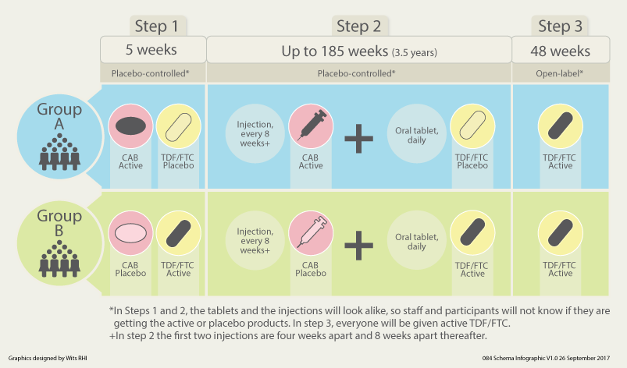
HPTN 083 and 084: Phase 3 for CAB LA PrEP
Objective: To evaluate the safety and efficacy of CAB LA compared to TDF/FTC for PrEP in HIV uninfected MSM/TGW (083) and cisgender women (084)

Slide 18
HPTN 083
PHASE 2B/3 INJECTABLE CABOTEGRAVIR COMPARED TO DAILY ORAL TDF/FTC FOR PREP IN CISGENDER MEN AND TRANSGENDER WOMEN WHO HAVE SEX WITH MEN
Raphael Landovitz
Beatriz Grinjsten
NIAID/DAIDS DSMB
May 9, 2019

Slide 19
Status of Site Activation
27 US sites
11 South American Sites
4 Asian sites
1 African site

Slide 20
Enrollment – May 9
Target Populations
3810
Age <30
TGW
US Black/AA
>50%
>10%
>50%
65%
12%
50%

Slide 21
HPTN 084
A Phase 3 Double Blind Safety and Efficacy Study of Long-Acting Injectable Cabotegravir Compared to Daily Oral TDF/FTC for Pre-Exposure Prophylaxis in HIV-Uninfected Women
Sinead Delany-Moretlwe
Mina Hosseinipour
NIAID/DAIDS DSMB
November, 2018

Slide 22




Study Population
3,200 women who have sex with men
Female
HIV negative
Age 18-45 years
Sexually active (vaginal intercourse twice in past 30 days)
Modified VOICE Risk Score 3
Not pregnant or breastfeeding
No previous enrollment in vaccine trial and no co-enrollment in other HIV prevention trials
No contraindications to either agent
3 Sites in Uganda
1 Site in Kenya
2 Sites in Malawi
1 Site in Botswana
7 Sites in South Africa
5 Sites in Zimbabwe
1 Site in Swaziland
Notes:
WHO has recommended that PrEP be offered to populations at substantial risk for HIV infection ie incidence =>3%
Need to enroll a population at risk
Endpoint driven trial and so have selected sites that are able to recruit a population at high risk for infection
Need geographical diversity so that we can ensure licensure in the region

Slide 23
Enrollment
Almost halfway!
Current enrolment n=1535
Since activation of all 20 sites, average enrolment/month 160
Accrual targeted to complete e/o April 2020
Source: SDMC, data to May 16, 2019

Slide 24
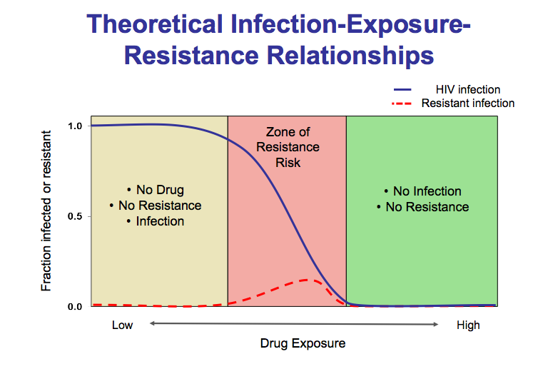
Long-Acting Agents: Good, Bad, or Ugly?
When administering agents with long t_{1/2} in non-removable method
May require an oral lead-in to assess toxicity before administering LA formulation
May have a prolonged sub-therapeutic tail
Markowitz et al, Lancet HIV 2017;4:e331-40

Slide 25
The name Biomedical Prevention Implementation Collaborative or “BioPIC” for short, reflects our objectives
BioPIC Objectives
Using CAB-LA as an initial example, develop and fine-tune an overarching product introduction framework that is adaptable to any future biomedical prevention, enabling stakeholders to quickly convert positive clinical trial results into public health impact.
Develop a comprehensive, coordinated product introduction agenda and access strategy in parallel with the clinical trials and ahead of their completion to ensure successful and rapid introduction of CAB-LA.
Notes:
SPEAKER - Mitchell

Slide 26
Challenges in Development of CAB-LA as PreP
Recruitment and retention!
Reduced HIV incidence (GOOD NEWS) with more ART and risk reduction behavior change may compromise anticipated study “endpoints”
Will STIs affect CAB-LA PrEP efficacy?
Analysis may be complicated: ITT vs “as treated” requires interpretation

Slide 27
THANK YOU FOR LISTENING

